Slide 1

Convolution Neural Network

Slide 3
Feature Map
1 | -1 | -2 | -1
-1 | -2 | -1 | -2
-2 | -1 | -2 | -1
-1 | -2 | -1 | 1
1 | 0 | 0 | 0
0 | 0 | 0 | 0
0 | 0 | 0 | 0
0 | 0 | 0 | 1
+ -2
Filter
(Convolution)
1 | 0
0 | 1
Input to NN
Max Pooling
1
x -0.8
1
+ 1.45
=
0
x -0.07
x -1.33
sum
+ -0.97
0
x 1.33
x 0.2
0
+ -0.45
=
1
x 0.17

Slide 4
Here, we have 36 connections from the 36 input node to this Hidden layer
0
6 pixel wide
0
1
1
0
0
0
0 | 0 | 1 | 1 | 0 | 0
0 | 1 | 0 | 0 | 1 | 0
1 | 0 | 0 | 0 | 0 | 1
1 | 0 | 0 | 0 | 0 | 1
0 | 1 | 0 | 0 | 1 | 0
0 | 0 | 1 | 1 | 0 | 0
1
0
0
1
0
1
0
0
0
0
sum
+ bias
6 pixel tall
1
1
0
0
0
0
1
0
1
0
We know that each connection has a weight that needs to be estimated using Backpropagation, meaning we need to estimate 36 weights
0
1
0
0
0
1
1
0
We convert this 6x6 grid of pixel into a single column of 36 input nodes
0

Slide 5
0
0
Usually the first Hidden layer has more than one node
1
1
0
0
0
1
6 pixel wide
0
0
1
0
1
0
0 | 0 | 1 | 1 | 0 | 0
0 | 1 | 0 | 0 | 1 | 0
1 | 0 | 0 | 0 | 0 | 1
1 | 0 | 0 | 0 | 0 | 1
0 | 1 | 0 | 0 | 1 | 0
0 | 0 | 1 | 1 | 0 | 0
0
0
0
sum
+ bias
1
1
0
0
0
0
1
6 pixel tall
0
1
0
0
sum
+ bias
1
0
0
0
1
1
0
0
We know that each connection has a weight that needs to be estimated using Backpropagation, meaning we need to estimate 36 weights. Each additional node adds 36 weights that need to be calculated.
We convert this 6x6 grid of pixel into a single column of 36 input nodes

Slide 6
0
0
1
1
0
0
0
1
6 pixel wide
0
0
1
0
1
0
0 | 0 | 1 | 1 | 0 | 0
0 | 1 | 0 | 0 | 1 | 0
1 | 0 | 0 | 0 | 0 | 1
1 | 0 | 0 | 0 | 0 | 1
0 | 1 | 0 | 0 | 1 | 0
0 | 0 | 1 | 1 | 0 | 0
0
0
0
sum
+ bias
1
1
0
0
0
0
1
6 pixel tall
0
1
0
0
sum
+ bias
1
0
0
0
1
1
0
0
Since our image is small only 6x6 pixel this could work but if we had a larger images say 100 pixel x 100 pixel then we would end up estimating 10000 Weights per node in Hidden Layer. So this method doesn't scale very well
We convert this 6x6 grid of pixel into a single column of 36 input nodes

Slide 7
Another problem is that we don't know if this Neural Network will still perform well if the image is shifted by one pixel.
If we use this image for Training
If we use this image for Testing
0 | 0 | 1 | 1 | 0 | 0
0 | 1 | 0 | 0 | 1 | 0
1 | 0 | 0 | 0 | 0 | 1
1 | 0 | 0 | 0 | 0 | 1
0 | 1 | 0 | 0 | 1 | 0
0 | 0 | 1 | 1 | 0 | 0
0 | 0 | 0 | 1 | 1 | 0
0 | 0 | 1 | 0 | 0 | 1
0 | 1 | 0 | 0 | 0 | 0
0 | 1 | 0 | 0 | 0 | 0
0 | 0 | 1 | 0 | 0 | 1
0 | 0 | 0 | 1 | 1 | 0
It is not clear if the Neural Network will still recognize this letter "O" correctly if each pixel is shifted to the right by one

Slide 8
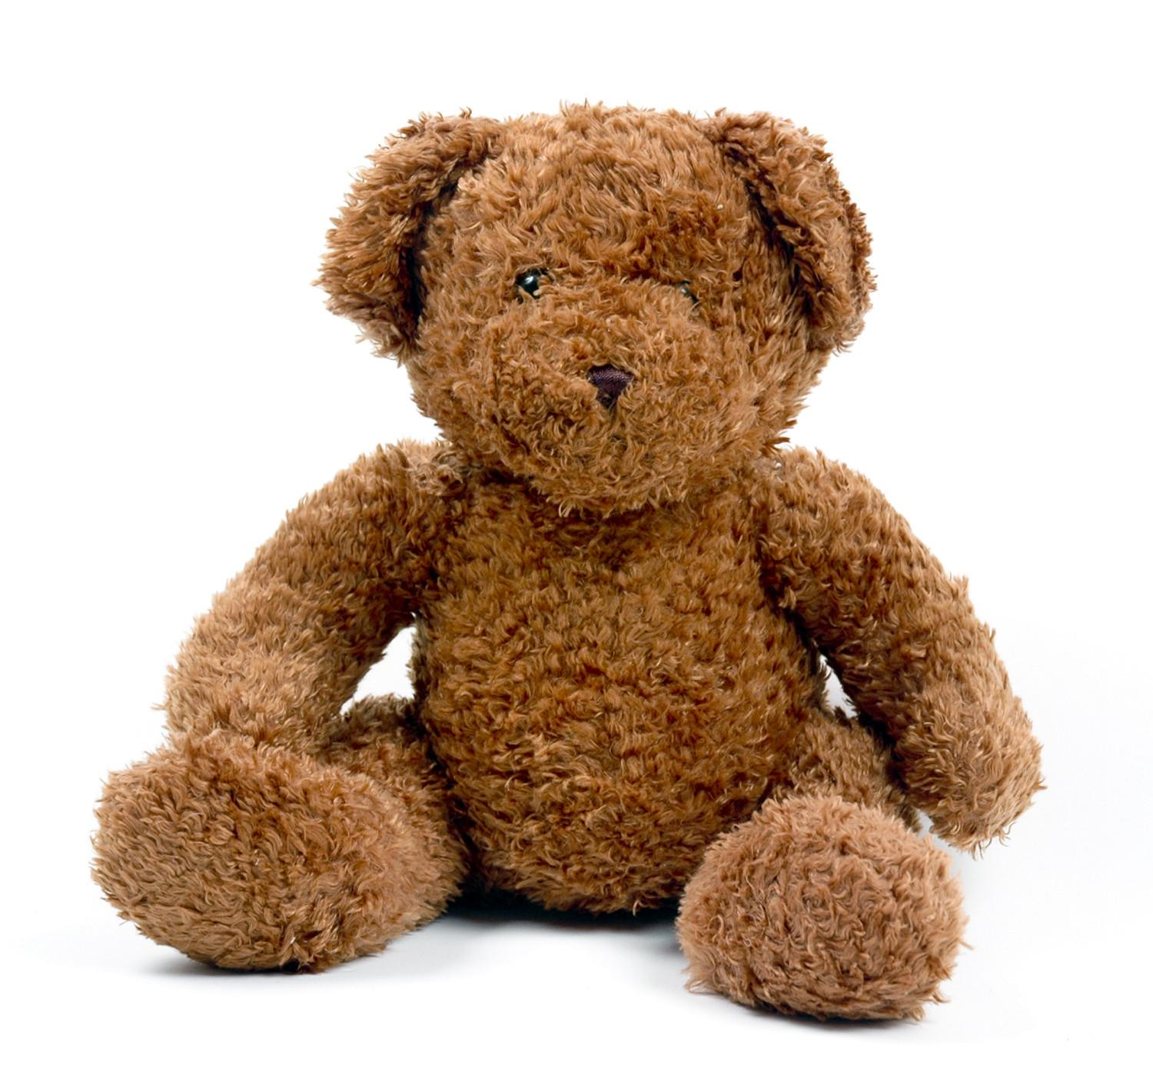
Complicated images like this teddy bear tend to have correlated pixels
Any white pixel tends to be closer to other white pixels
Any brownish pixel in this image tends to be close to other brownish pixels
Thus, it might be helpful if we can take advantage of this correlation that exists among pixels. Thus classification of large and complicated images usually done using something called a Convolution Neural Network

Slide 9
0
0
1
1
0
0
0
1
6 pixel wide
0
0
1
0
1
0
0 | 0 | 1 | 1 | 0 | 0
0 | 1 | 0 | 0 | 1 | 0
1 | 0 | 0 | 0 | 0 | 1
1 | 0 | 0 | 0 | 0 | 1
0 | 1 | 0 | 0 | 1 | 0
0 | 0 | 1 | 1 | 0 | 0
0
0
0
sum
+ bias
1
1
0
0
0
0
1
6 pixel tall
0
1
0
0
sum
+ bias
1
0
0
0
1
1
0
0
Some characteristics of Convolution Neural Networks:
Reduce the number of input nodes
Tolerate small shifts in where the pixels are in the image
Take advantage of the correlation we observe in complex images
We convert this 6x6 grid of pixel into a single column of 36 input nodes

Slide 10
First thing that a convolution neural network does is applies a filter to the image
Input image
0 | 0 | 1 | 1 | 0 | 0
0 | 1 | 0 | 0 | 1 | 0
1 | 0 | 0 | 0 | 0 | 1
1 | 0 | 0 | 0 | 0 | 1
0 | 1 | 0 | 0 | 1 | 0
0 | 0 | 1 | 1 | 0 | 0
Filter
0 | 0 | 1
0 | 1 | 0
1 | 0 | 0
3 pixels
3 pixels
In Convolution Neural Networks a filter is just a smaller square that is commonly 3 pixel by 3 pixels. The intensity of each pixel is determined by back propagation. We start with random values for the filter and after training end up with something more useful.

Slide 11
To apply the filter to the image, we overlay the Filter onto the image…
Input image
Filter
0 | 0 | 1 | 1 | 0 | 0
0 | 1 | 0 | 0 | 1 | 0
1 | 0 | 0 | 0 | 0 | 1
1 | 0 | 0 | 0 | 0 | 1
0 | 1 | 0 | 0 | 1 | 0
0 | 0 | 1 | 1 | 0 | 0
This sum is called the Dot Product
0 | 0 | 1
0 | 1 | 0
1 | 0 | 0
(0 x 0) + (0 x 0) + (0 x 0)
(0 x 0) + (1 x 1) + (0 x 0)
(1 x 1) + (0 x 0) + (0 x 0)
= 3
In Convolution Neural Networks a filter is just a smaller square that is commonly 3 pixel by 3 pixels. The intensity of each pixel is determined by back propagation. We start with random values for the filter and after training end up with something more useful.

Slide 12
Input image
Filter
0 | 0 | 1 | 1 | 0 | 0
0 | 1 | 0 | 0 | 1 | 0
1 | 0 | 0 | 0 | 0 | 1
1 | 0 | 0 | 0 | 0 | 1
0 | 1 | 0 | 0 | 1 | 0
0 | 0 | 1 | 1 | 0 | 0
By computing the Dot Product between the Input and the Filter, we can say that the Filter is Convolved with the input and that's what gives Convolution Neural Networks their name
0 | 0 | 1
0 | 1 | 0
1 | 0 | 0
(0 x 0) + (0 x 0) + (0 x 0)
(0 x 0) + (1 x 1) + (0 x 0)
(1 x 1) + (0 x 0) + (0 x 0)
= 3

Slide 13
Input image
Filter
Feature Map
0 | 0 | 1 | 1 | 0 | 0
0 | 1 | 0 | 0 | 1 | 0
1 | 0 | 0 | 0 | 0 | 1
1 | 0 | 0 | 0 | 0 | 1
0 | 1 | 0 | 0 | 1 | 0
0 | 0 | 1 | 1 | 0 | 0
0 | 0 | 1
0 | 1 | 0
1 | 0 | 0
1 | -1 | -2 | -1
-1 | -2 | -1 | -2
-2 | -1 | -2 | -1
-1 | -2 | -1 | 1
+ -2
(0 x 0) + (0 x 0) + (0 x 0)
(0 x 0) + (1 x 1) + (0 x 0)
(1 x 1) + (0 x 0) + (0 x 0)
= 3

Slide 14
Input image
Filter
Feature Map
0 | 0 | 1 | 1 | 0 | 0
0 | 1 | 0 | 0 | 1 | 0
1 | 0 | 0 | 0 | 0 | 1
1 | 0 | 0 | 0 | 0 | 1
0 | 1 | 0 | 0 | 1 | 0
0 | 0 | 1 | 1 | 0 | 0
0 | 0 | 1
0 | 1 | 0
1 | 0 | 0
1 | -1 | -2 | -1
-1 | -2 | -1 | -2
-2 | -1 | -2 | -1
-1 | -2 | -1 | 1
+ -2
(0 x 0) + (0 x 0) + (0 x 0)
(0 x 0) + (1 x 1) + (0 x 0)
(1 x 1) + (0 x 0) + (0 x 0)
= 3
ReLU Activation function

